Slide 1
SpaceX Rocket Landing Predictive Analysis (Data Science and machine Learning Capstone project)

Slide 2
Executive Summary
In this project, we embarked on a journey through the realm of data science, exploring various methodologies to analyze and derive insights from datasets. Our objective was to delve into the SpaceX Falcon 9 first stage landing prediction, a critical aspect of space exploration and cost optimization in the aerospace industry.
Key Findings:
Leveraging machine learning algorithms, we successfully predicted the landing outcome of Falcon 9 first stages.
Our analysis revealed significant cost savings potential by accurately predicting first stage landings.
Methodologies Used:
Data collection and wrangling
Exploratory data analysis (EDA) with interactive visual analytics
Predictive analysis using machine learning algorithms

Slide 3
Introduction
Our journey began with a clear problem statement: to predict the landing outcome of Falcon 9 first stages. With the rise of reusable rocket technology, accurate landing predictions are crucial for cost-effective space missions. We aimed to explore datasets related to SpaceX Falcon 9 launches and landings to address this challenge.

Slide 4
Data Collection and Data Wrangling Methodology
Data Collection:
We obtained datasets from reliable sources, including SpaceX and NASA, containing information on Falcon 9 launches and landing outcomes.
Data Wrangling:
We cleaned and preprocessed the data, handling missing values and ensuring data consistency.
Challenges such as inconsistent formatting and data discrepancies were addressed during this phase.

Slide 5
EDA and Interactive Visual Analytics Methodology
Exploratory Data Analysis (EDA):
Utilizing descriptive statistics and data visualization techniques, we gained insights into the characteristics and patterns of Falcon 9 launch and landing data.
Interactive Visual Analytics:
Leveraging tools like Matplotlib and Seaborn, we created interactive visualizations to explore the data dynamically.
These visualizations enabled deeper exploration and understanding of the dataset.

Slide 6
Predictive Analysis Methodology
Predictive Analysis:
We applied machine learning algorithms, including logistic regression, support vector machines (SVM), decision trees, and k-nearest neighbors (KNN), to predict Falcon 9 landing outcomes.
The dataset was split into training and testing sets for model training and evaluation.
Model Evaluation:
Performance metrics such as accuracy, precision, recall, and F1 score were used to evaluate the predictive models.

Slide 7
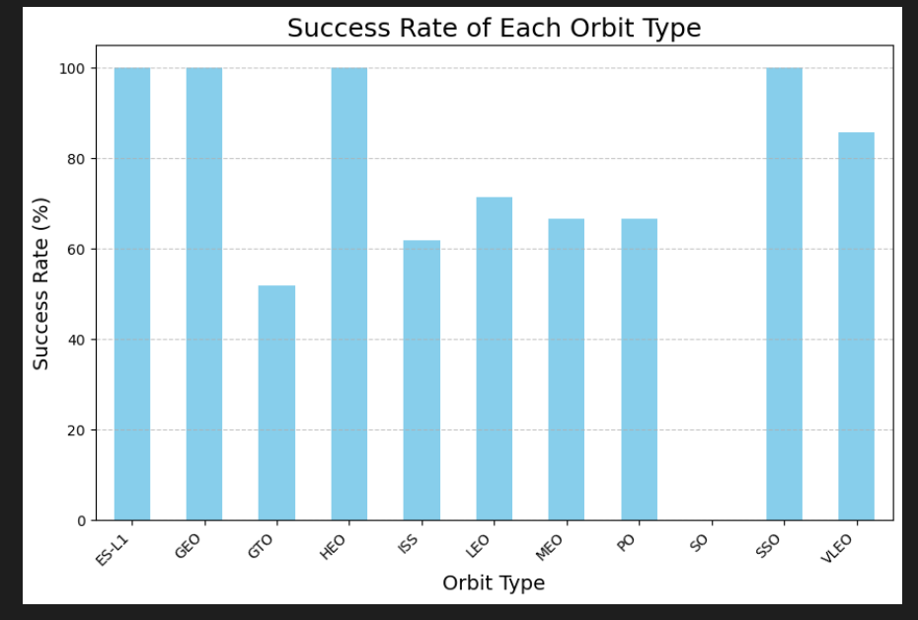
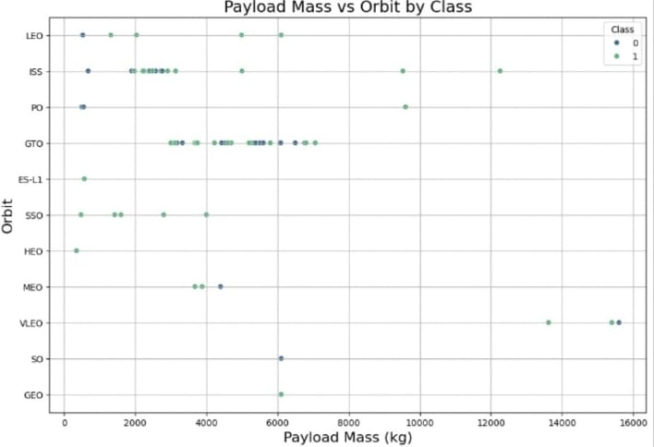
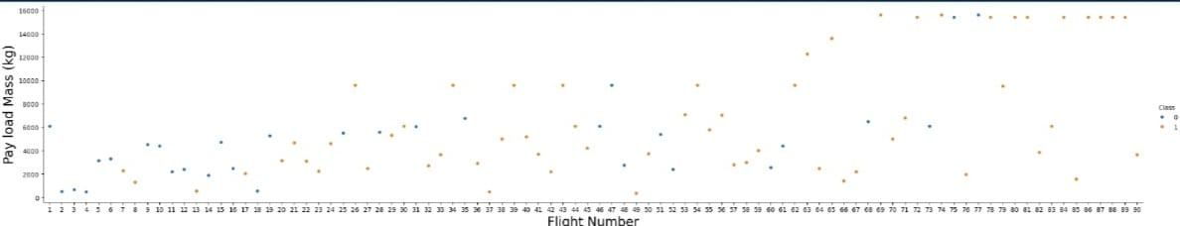
EDA with visualization results:

Slide 8
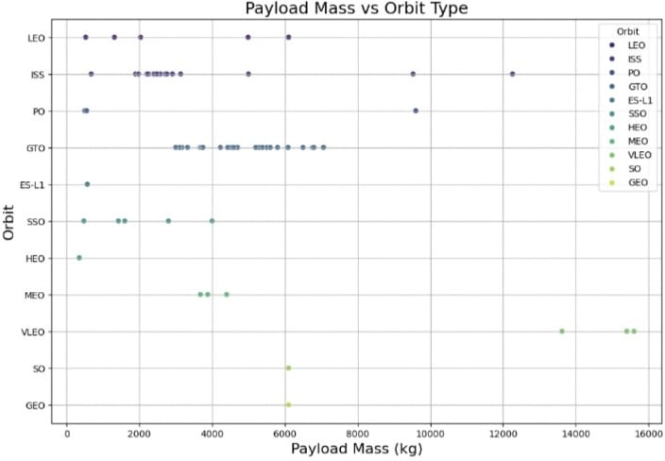
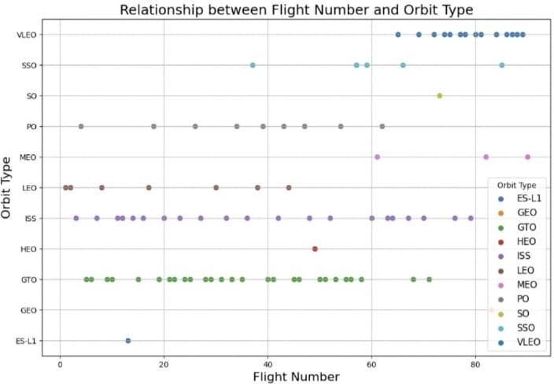
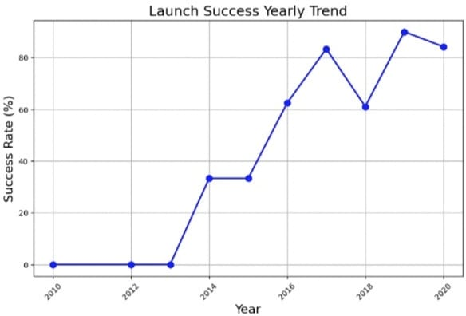

Slide 9
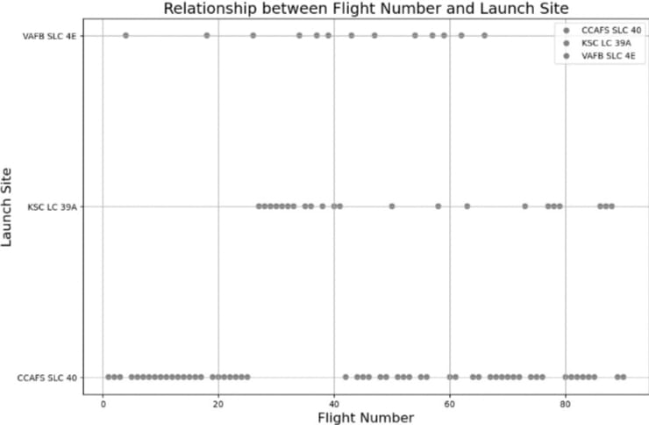
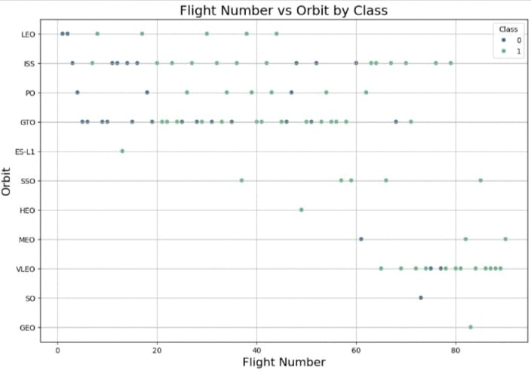
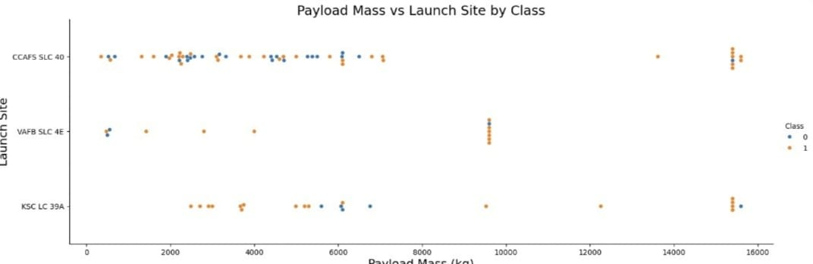

Slide 10
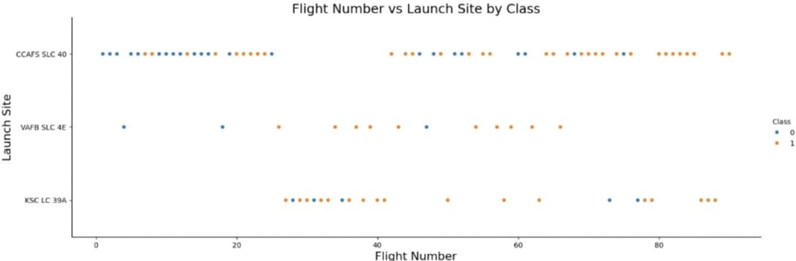
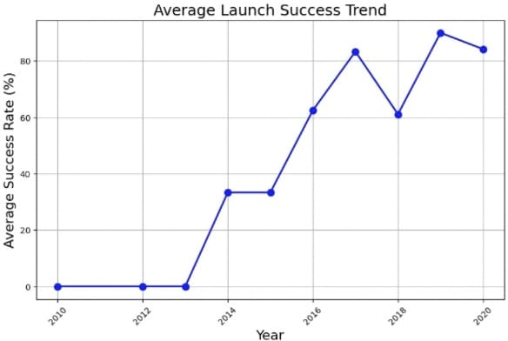

Slide 11
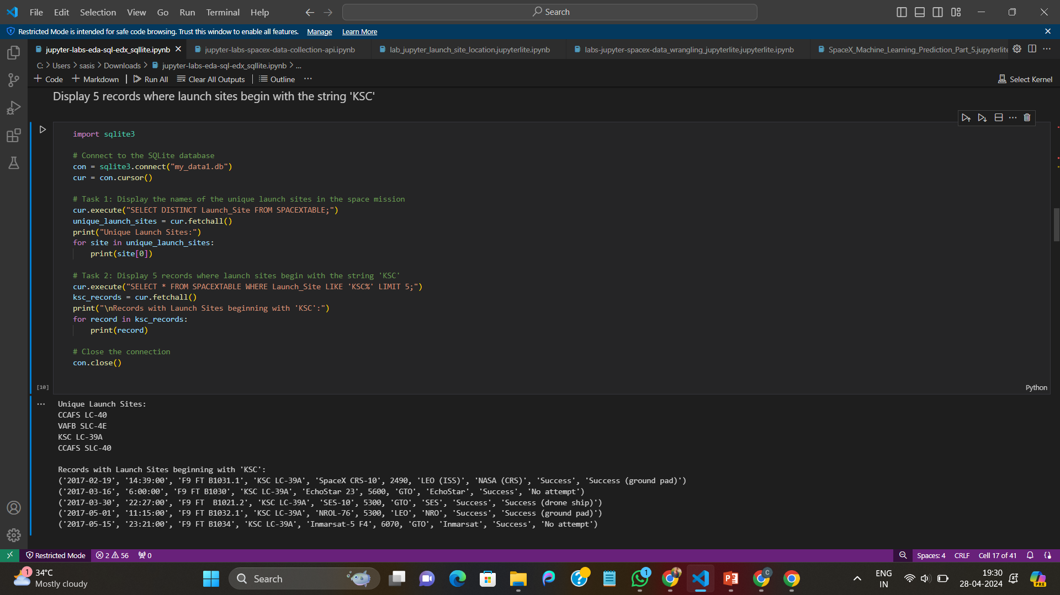
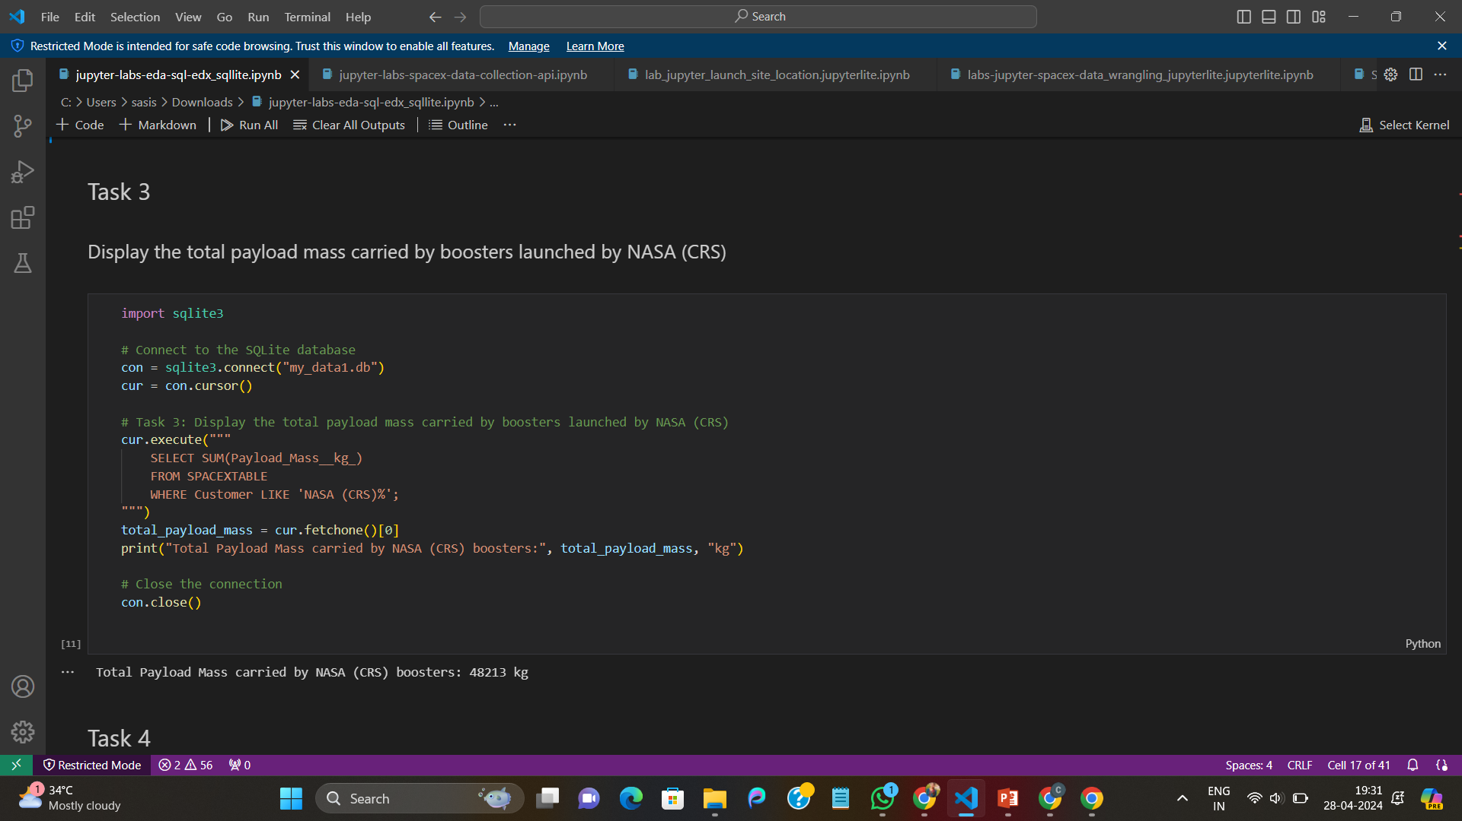
EDA With SQL RESULTS:

Slide 12
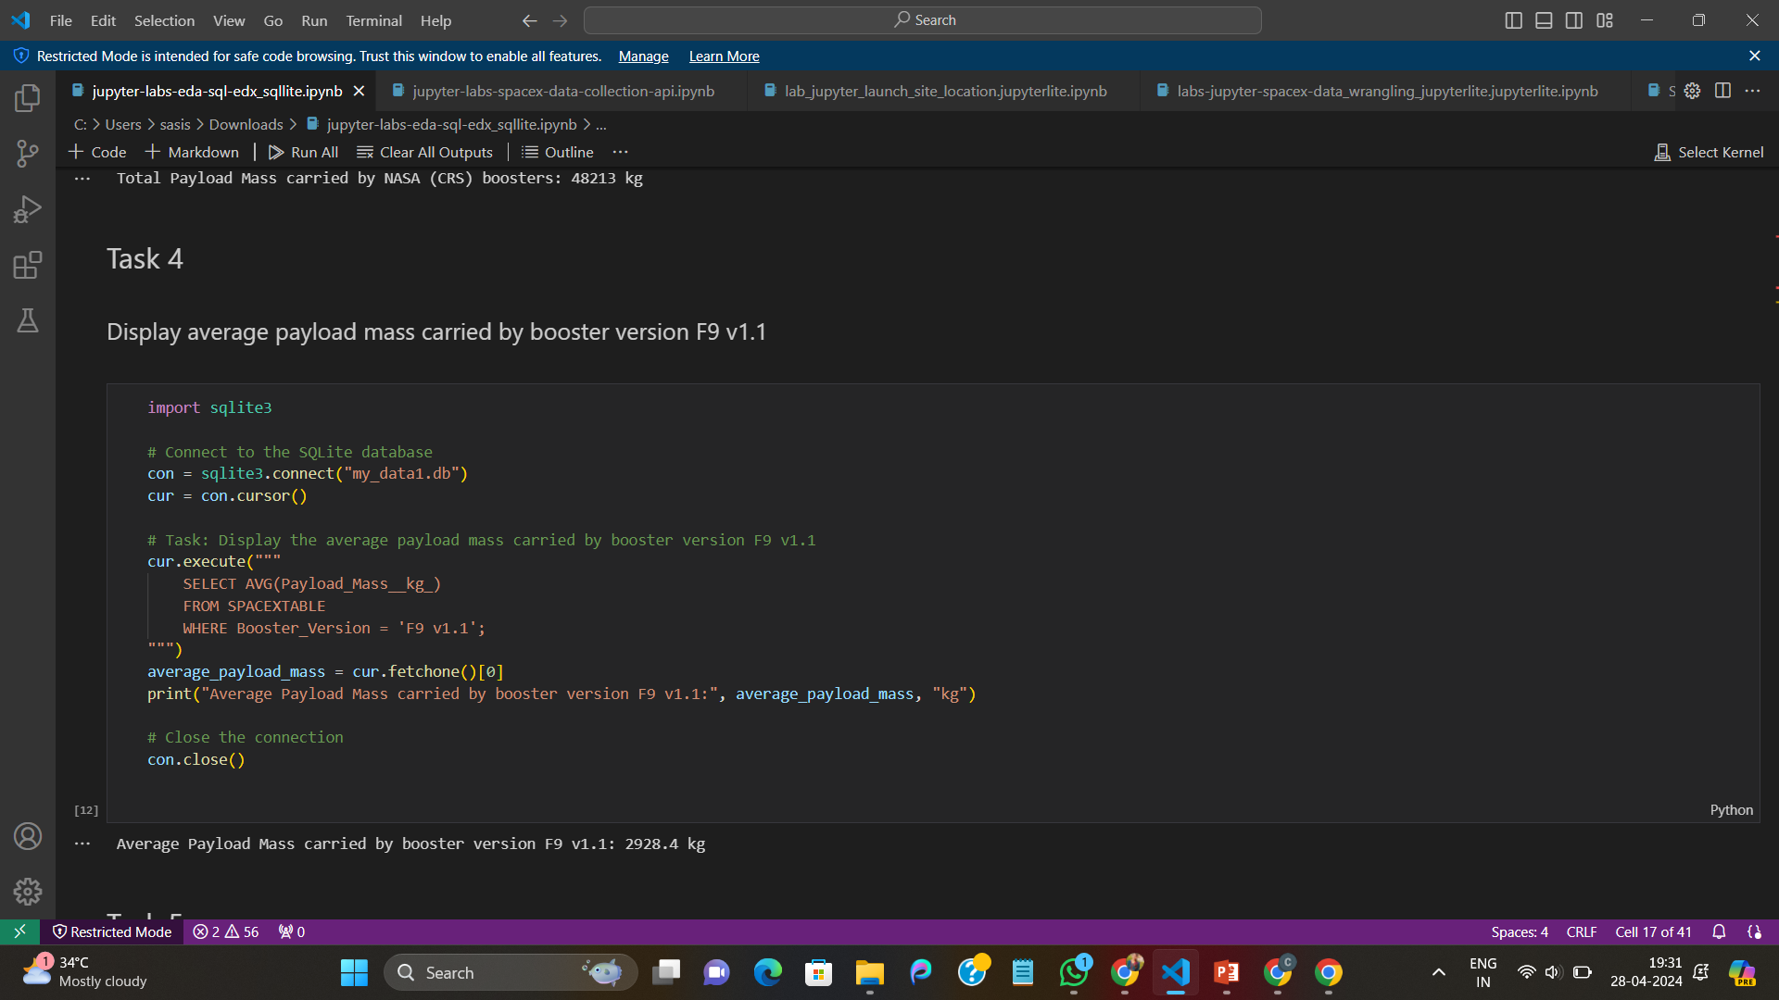
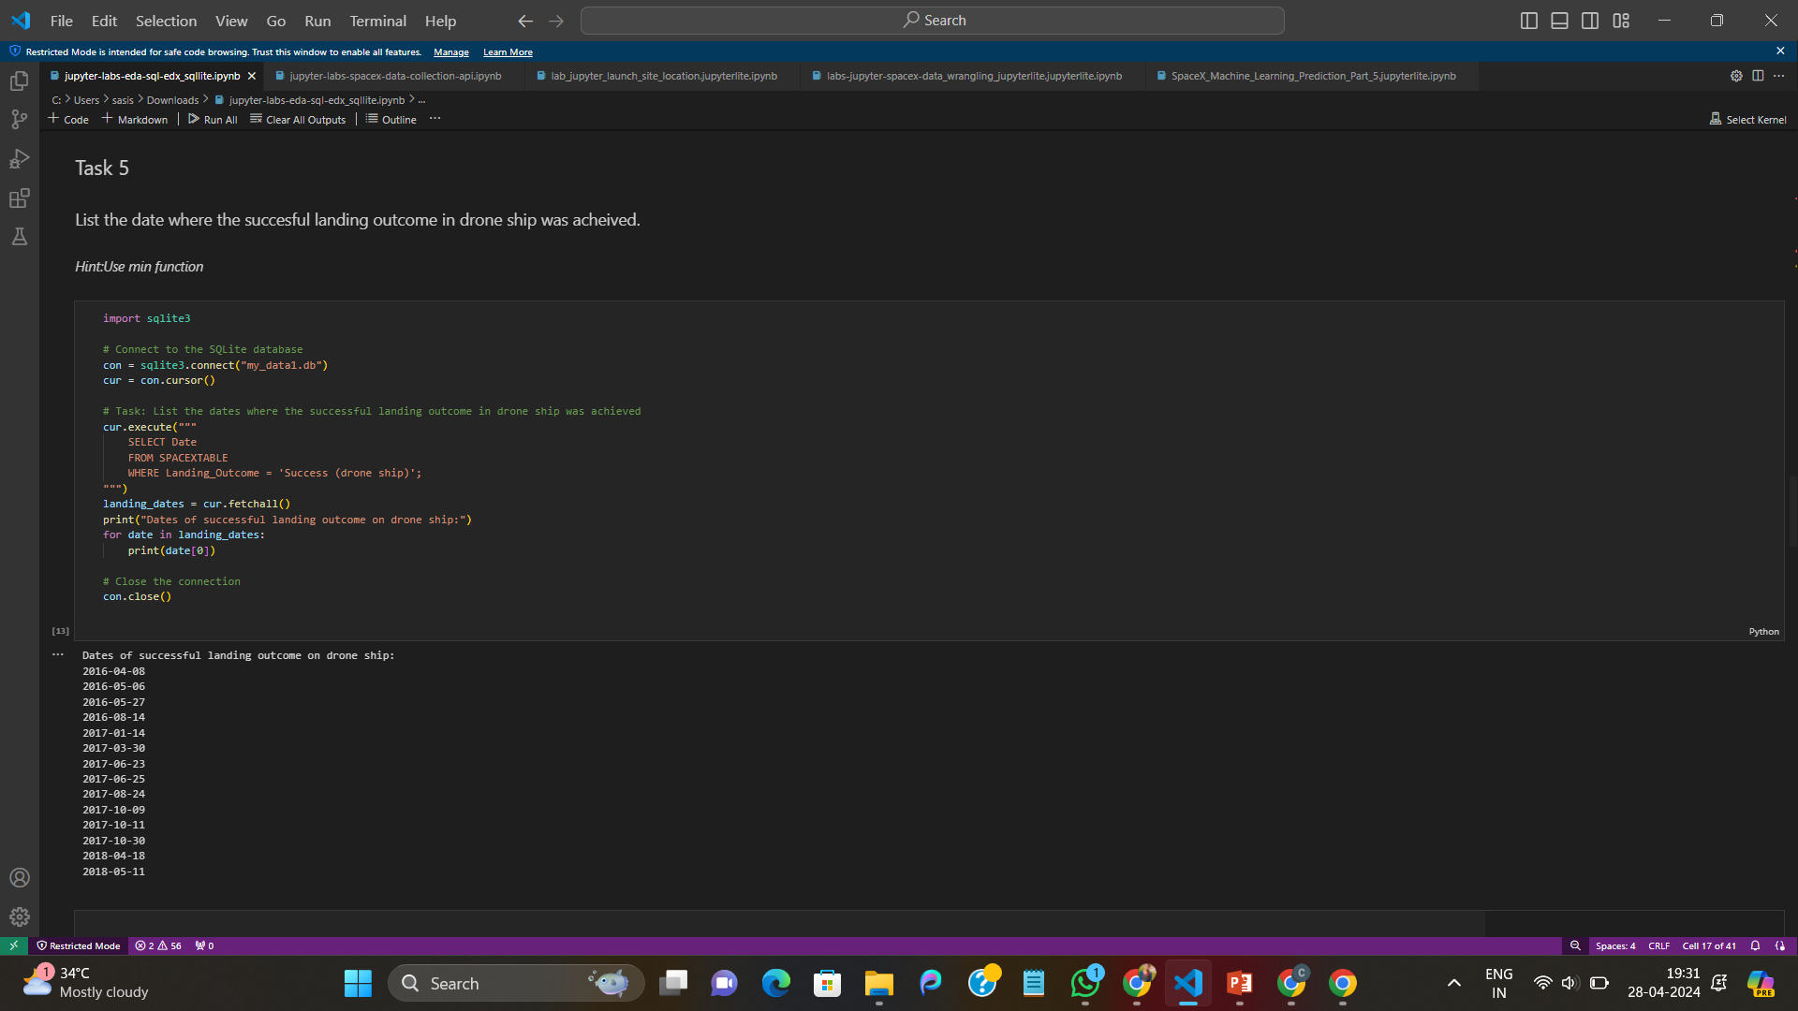

Slide 13
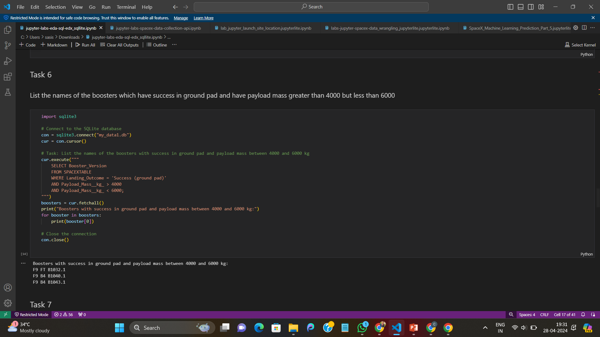
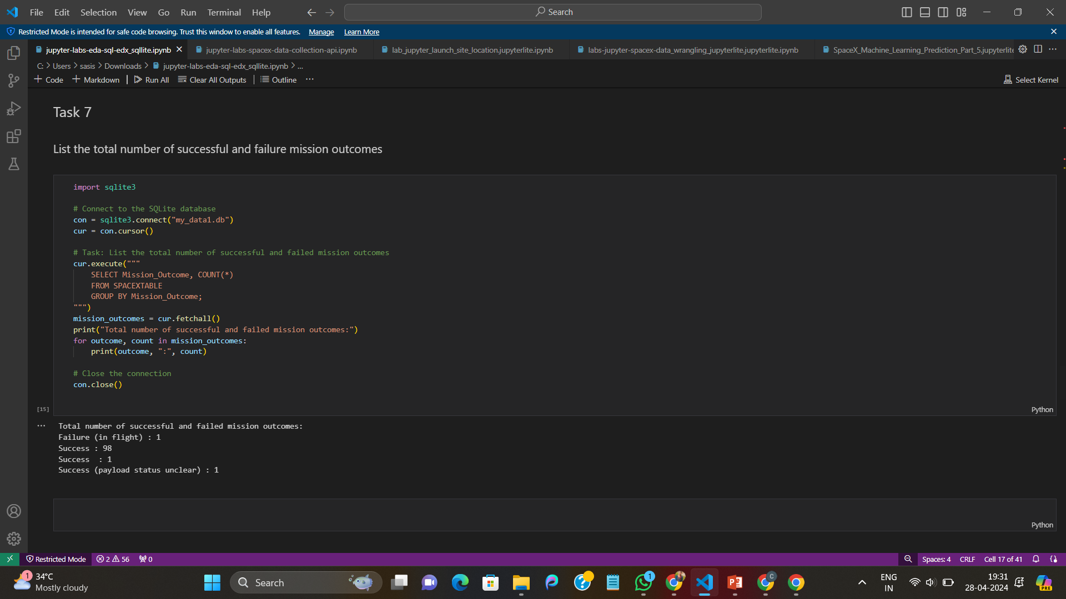

Slide 14
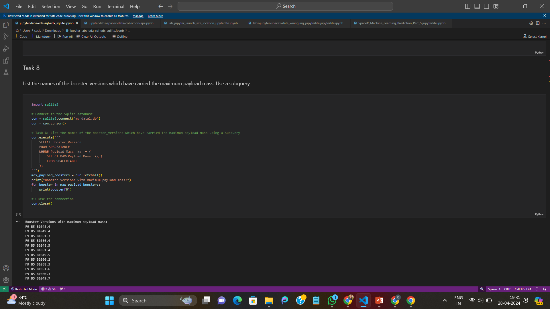
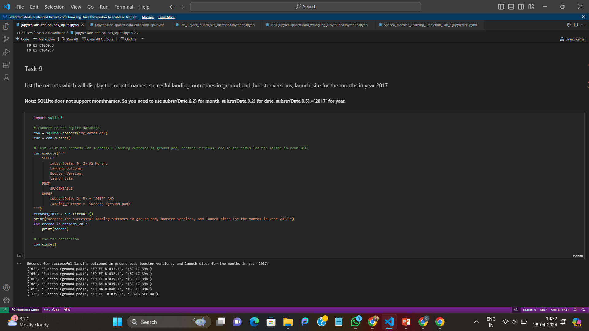

Slide 15
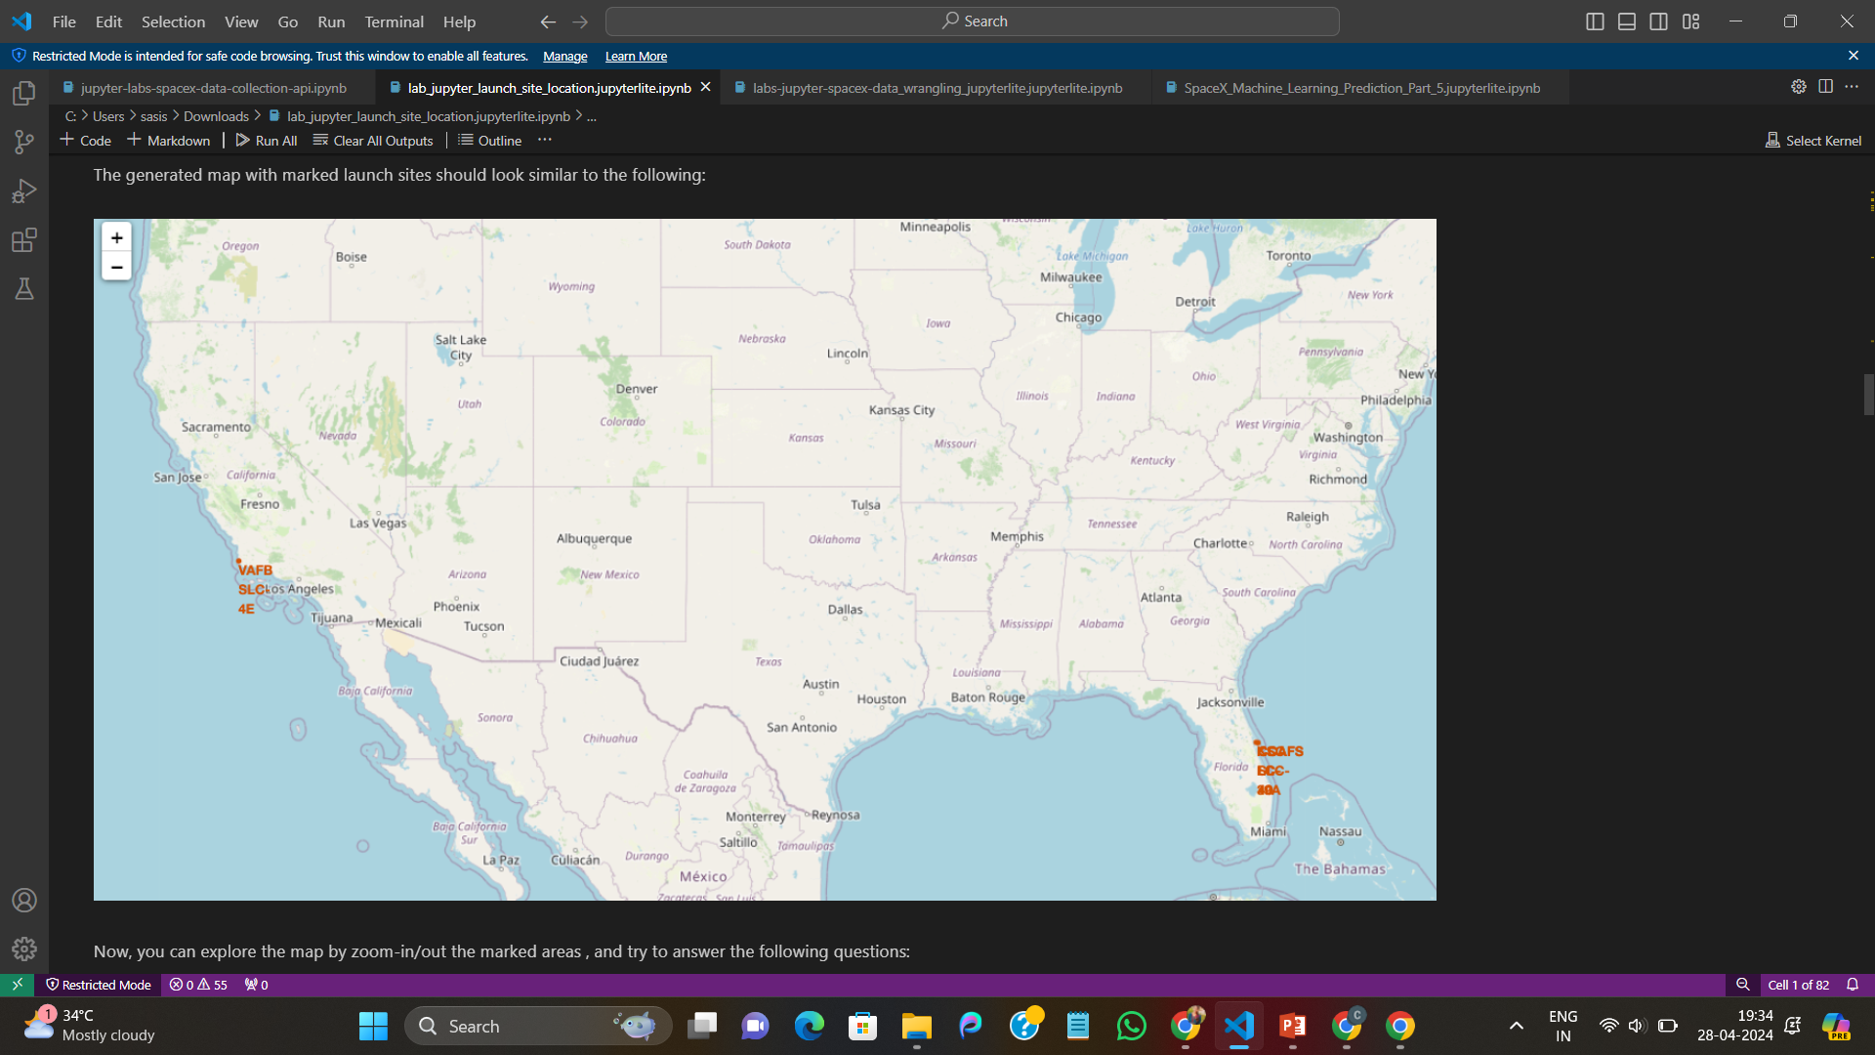
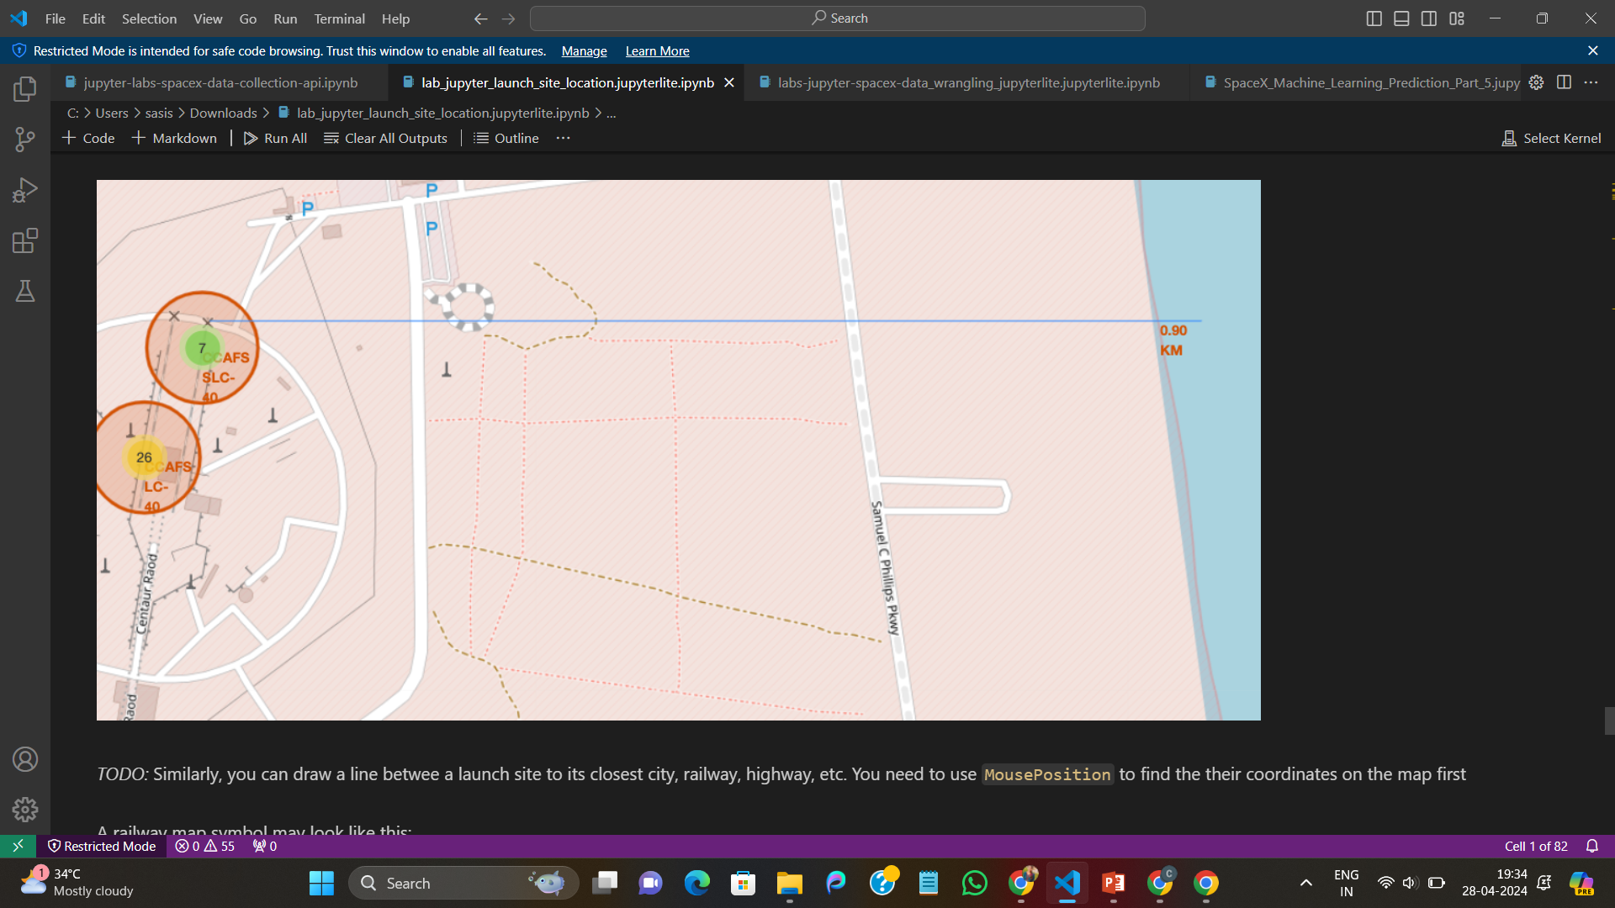
FOLIUM:

Slide 16
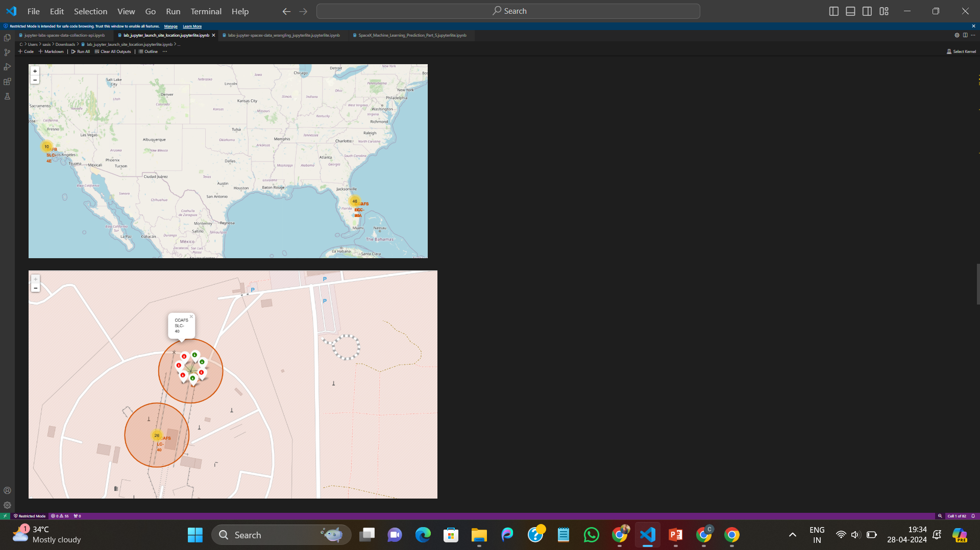

Slide 17
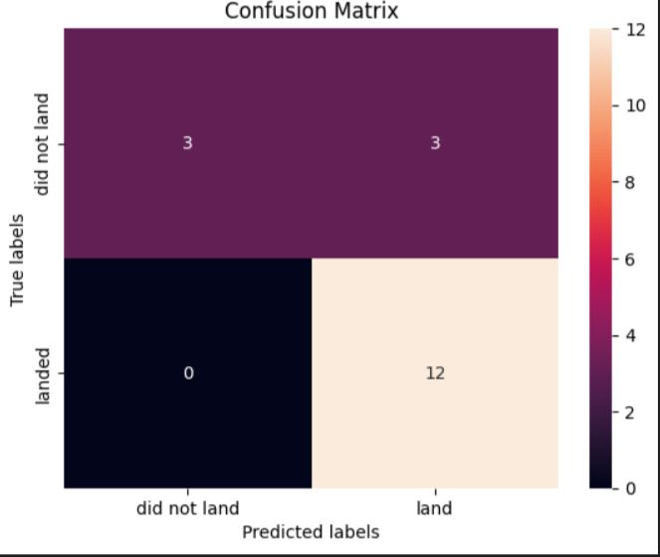
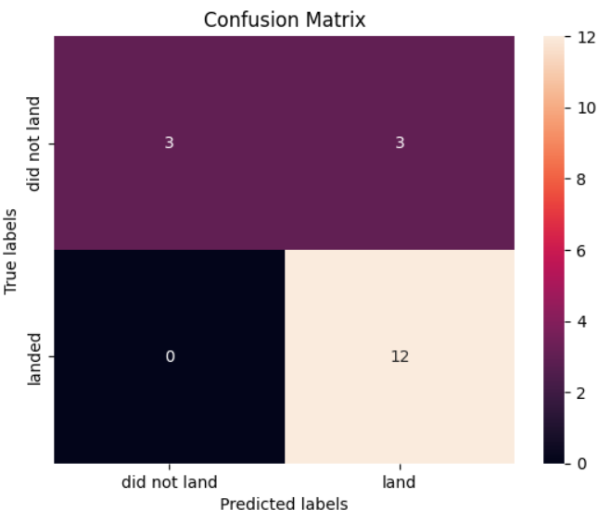
PREDICTIVE ANALYSIS RESULTS:
Logistic Regression
Support Vector Machine

Slide 18
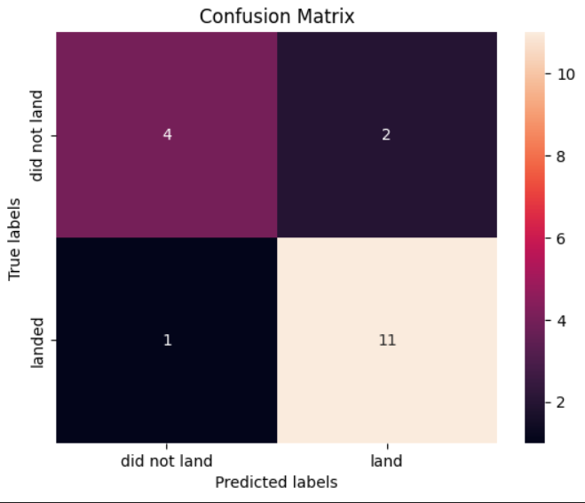
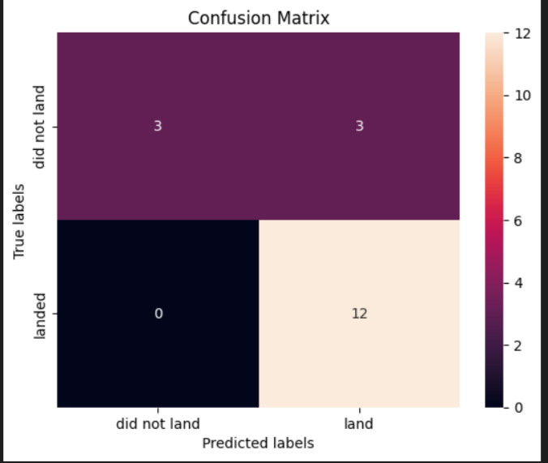
Decision Tree Classifier
K-Neighbors Classifier

Slide 19
Conclusion:
In conclusion, the project demonstrated the power of geospatial visualization techniques in analyzing and understanding complex spatial data related to space launch operations. The insights gained from this analysis contribute to ongoing efforts in advancing space exploration and technology development. Our analysis revealed significant cost savings potential by accurately predicting first stage landings.

